Slide 1
Data Visualization Principles
Catherine DeRose, PhD | HILT-2019
CC-BY

Slide 2
Why focus on design?
“the phrase ‘it’s not just about making pretty pictures’ is a common and vehement assertion in vis, meaning that the goals of the designer are not met if the result is beautiful but not effective” (12)
- Tamara Munzner, Visualization Analysis and Design

Slide 3
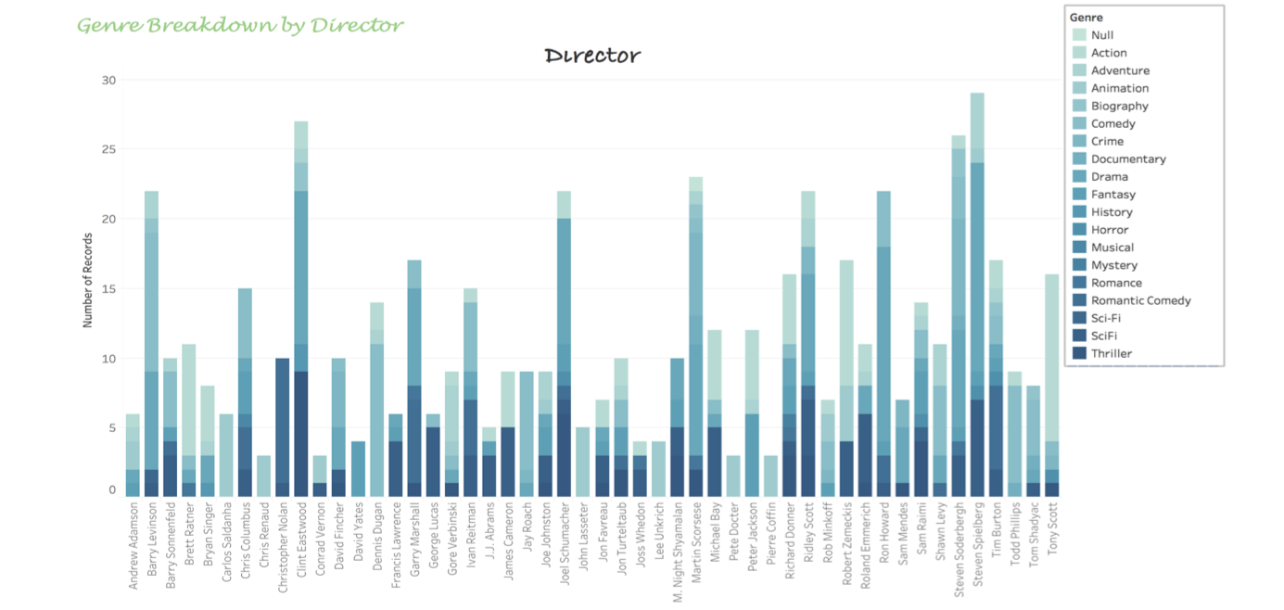
Exercise: Vis Critique
Note features that stand out, are confusing, or might be improved

Slide 4
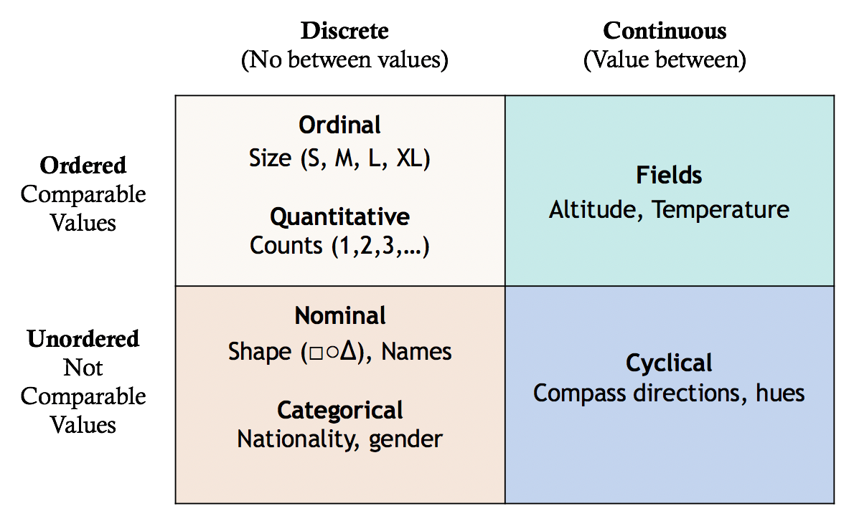
Data Types
Image by Joshua Dull (Yale University)

Slide 5
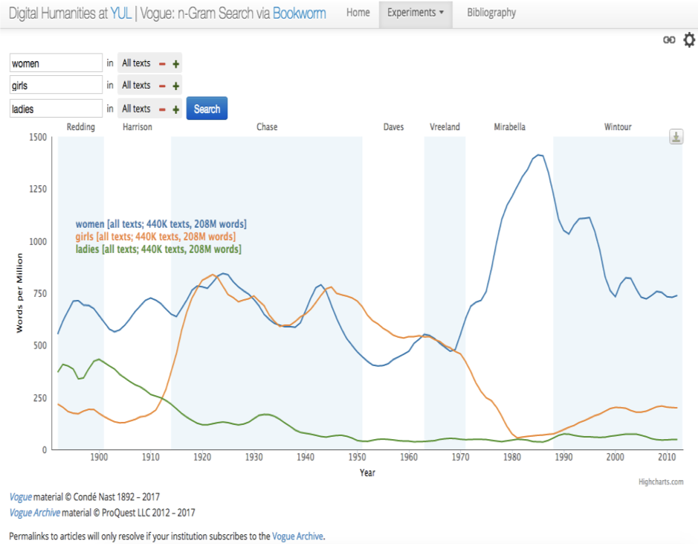
Line Graph
Continuous data
Change over time

Slide 6

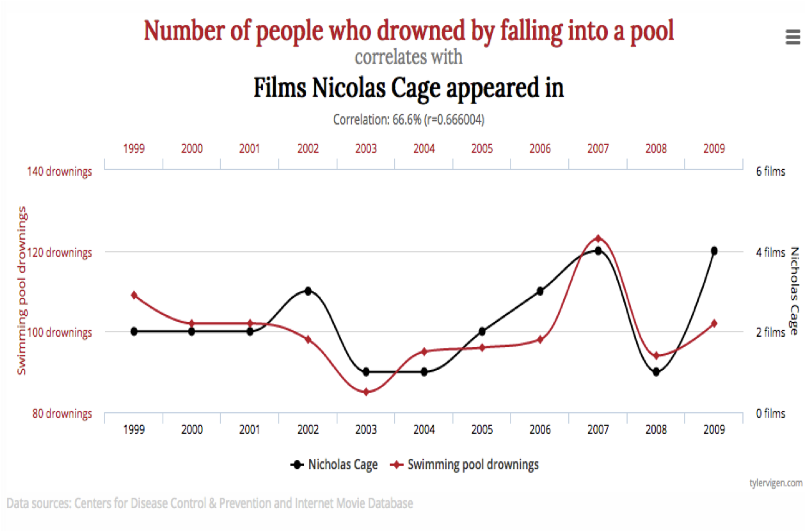

Slide 7
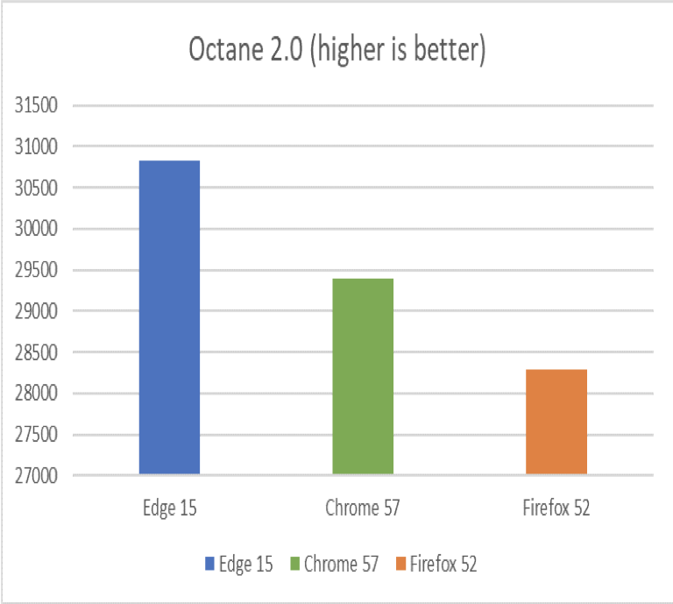
Bar Chart
Categorical data
Comparing groups

Slide 8

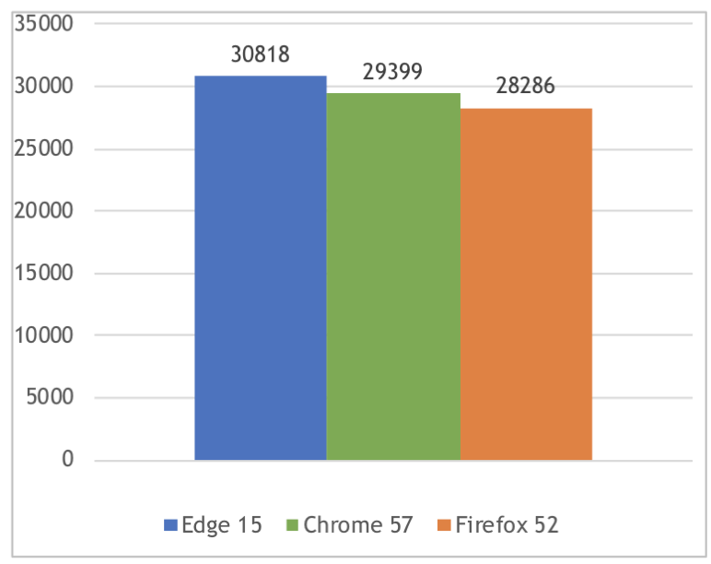
Axis Manipulation: Truncated Axis
x-axis graph by Joshua Dull (Yale University)

Slide 9
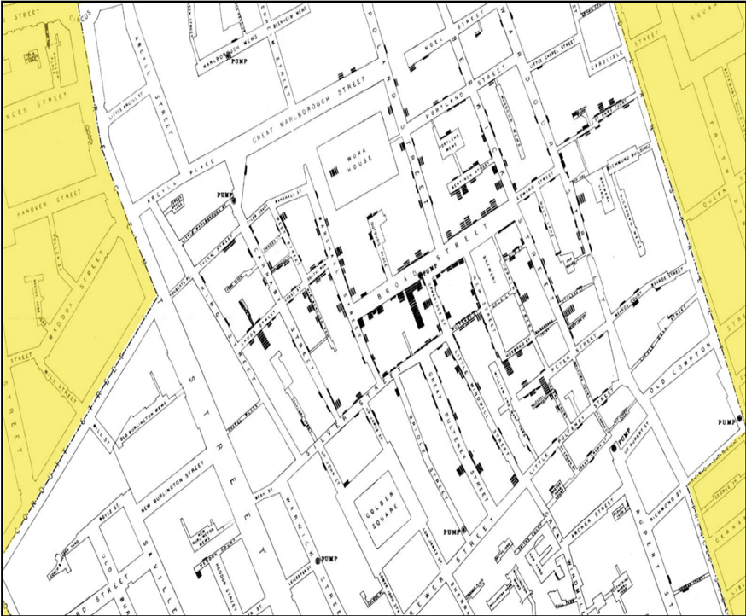
Maps
Spatial data
Geographic clustering
Comparing data about locations
Directions

Slide 10
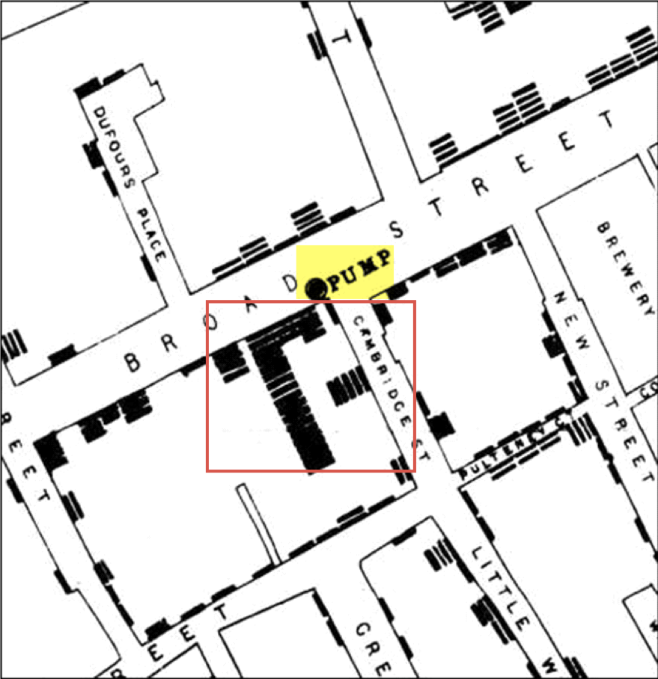

Slide 11
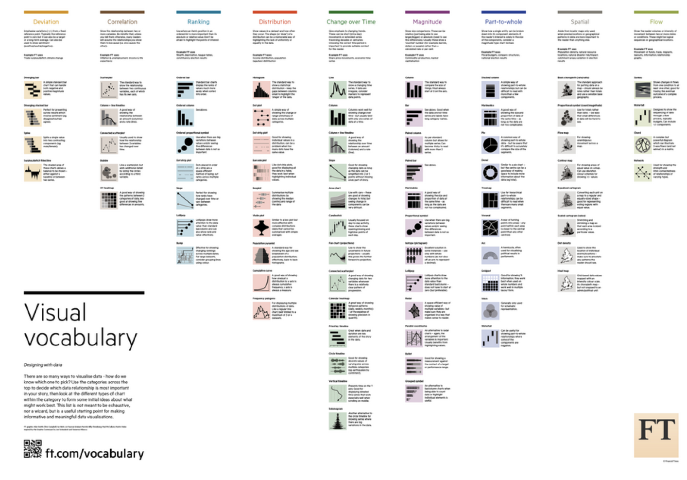

Slide 12
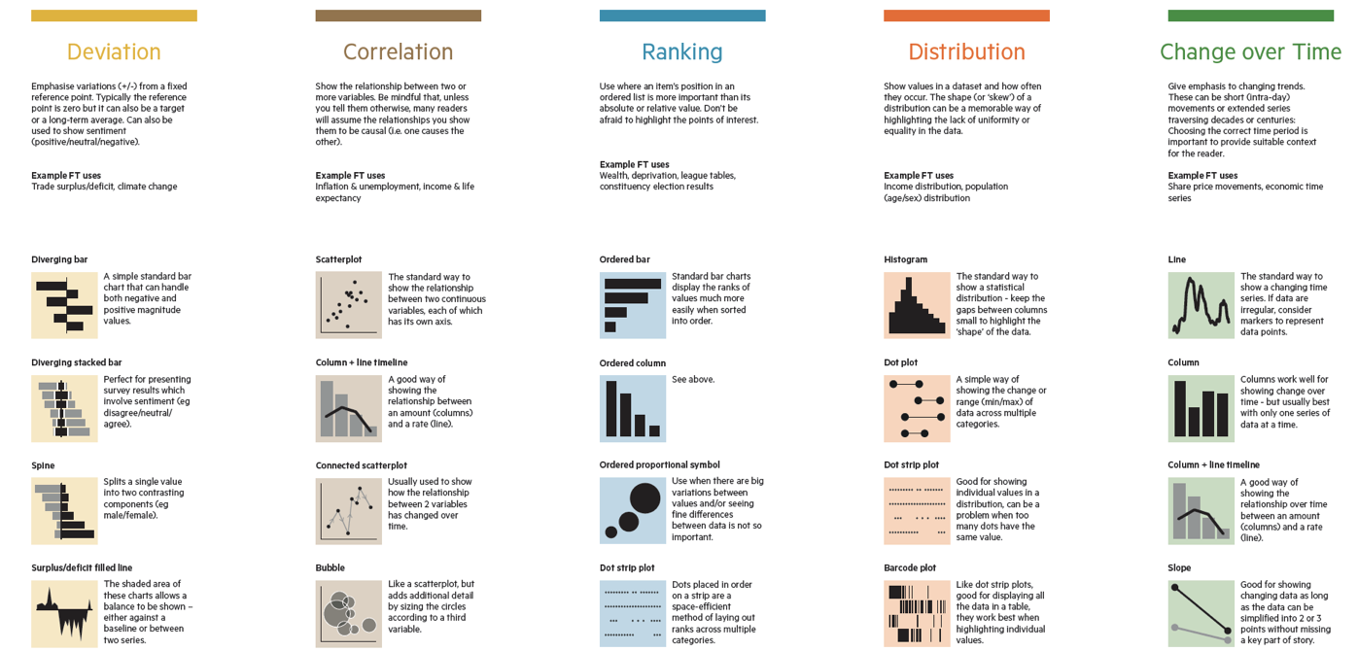
Notes:
Close-up example

Slide 13
Design: Human Perception

Slide 14

Proximity
We group objects that are spatially close to one another, assuming they are connected.

Slide 15


Similarity
We assume objects with shared visual properties are connected.

Slide 16

Color
Color immediately stands out and can be effective for calling attention to specific objects.

Slide 17
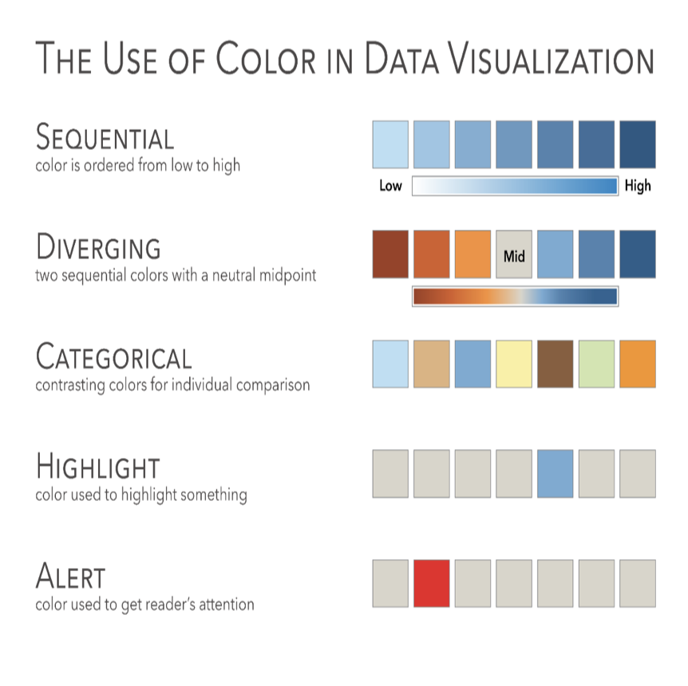
Image source: The Big Book of Dashboards (Fig. 1.16)

Slide 18

Size
Differences in size can stand out quickly and are assumed to have something to do with quantity.

Slide 19

Orientation
Orientation can have a pop-out effect, depending on the degree of difference.

Slide 20

Shape
Shape stands out, but we can’t visually group by it as quickly as we can with color.

Slide 21

Find the blue dot
Color only, 20 objects

Slide 22

Find the blue dot
Color only, 100 objects

Slide 23

Find the blue dot
Shape only, 20 objects

Slide 24

Find the blue dot
Shape only, 100 objects

Slide 25

Find the blue dot
Color and shape, 100 objects

Slide 26
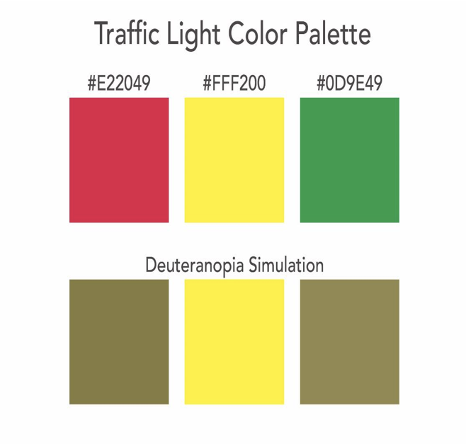
Image source: The Big Book of Dashboards (Fig. 33.8)

Slide 27
Practice with Tableau

Slide 28

Tableau Public
WHAT: Free visualization suite
WHY: Provides an overview of the data, lets users toggle between different visualizations in a single click, publishes to the web
HOW: Works locally, save publicly

Slide 29
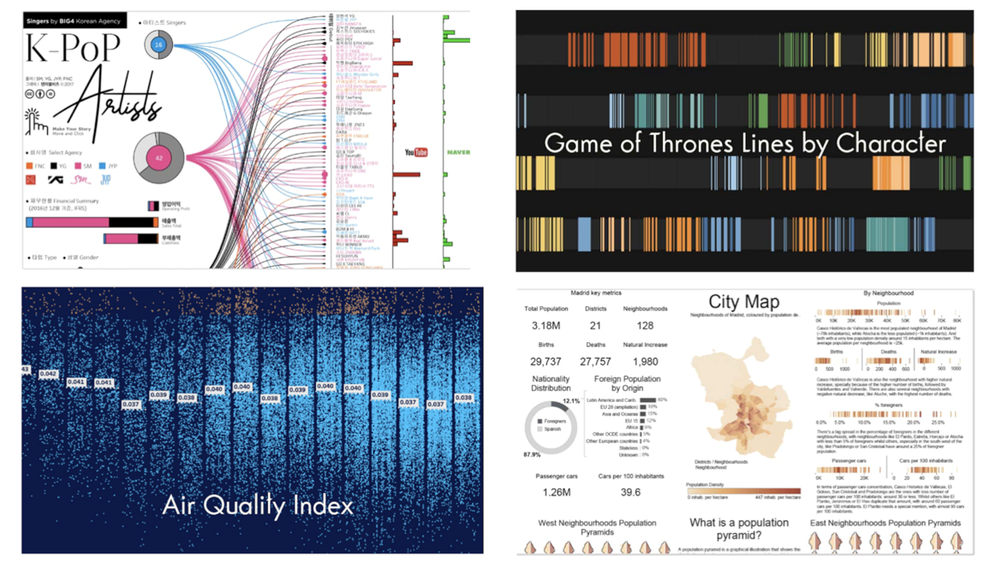
Tableau Public Samples

Slide 30
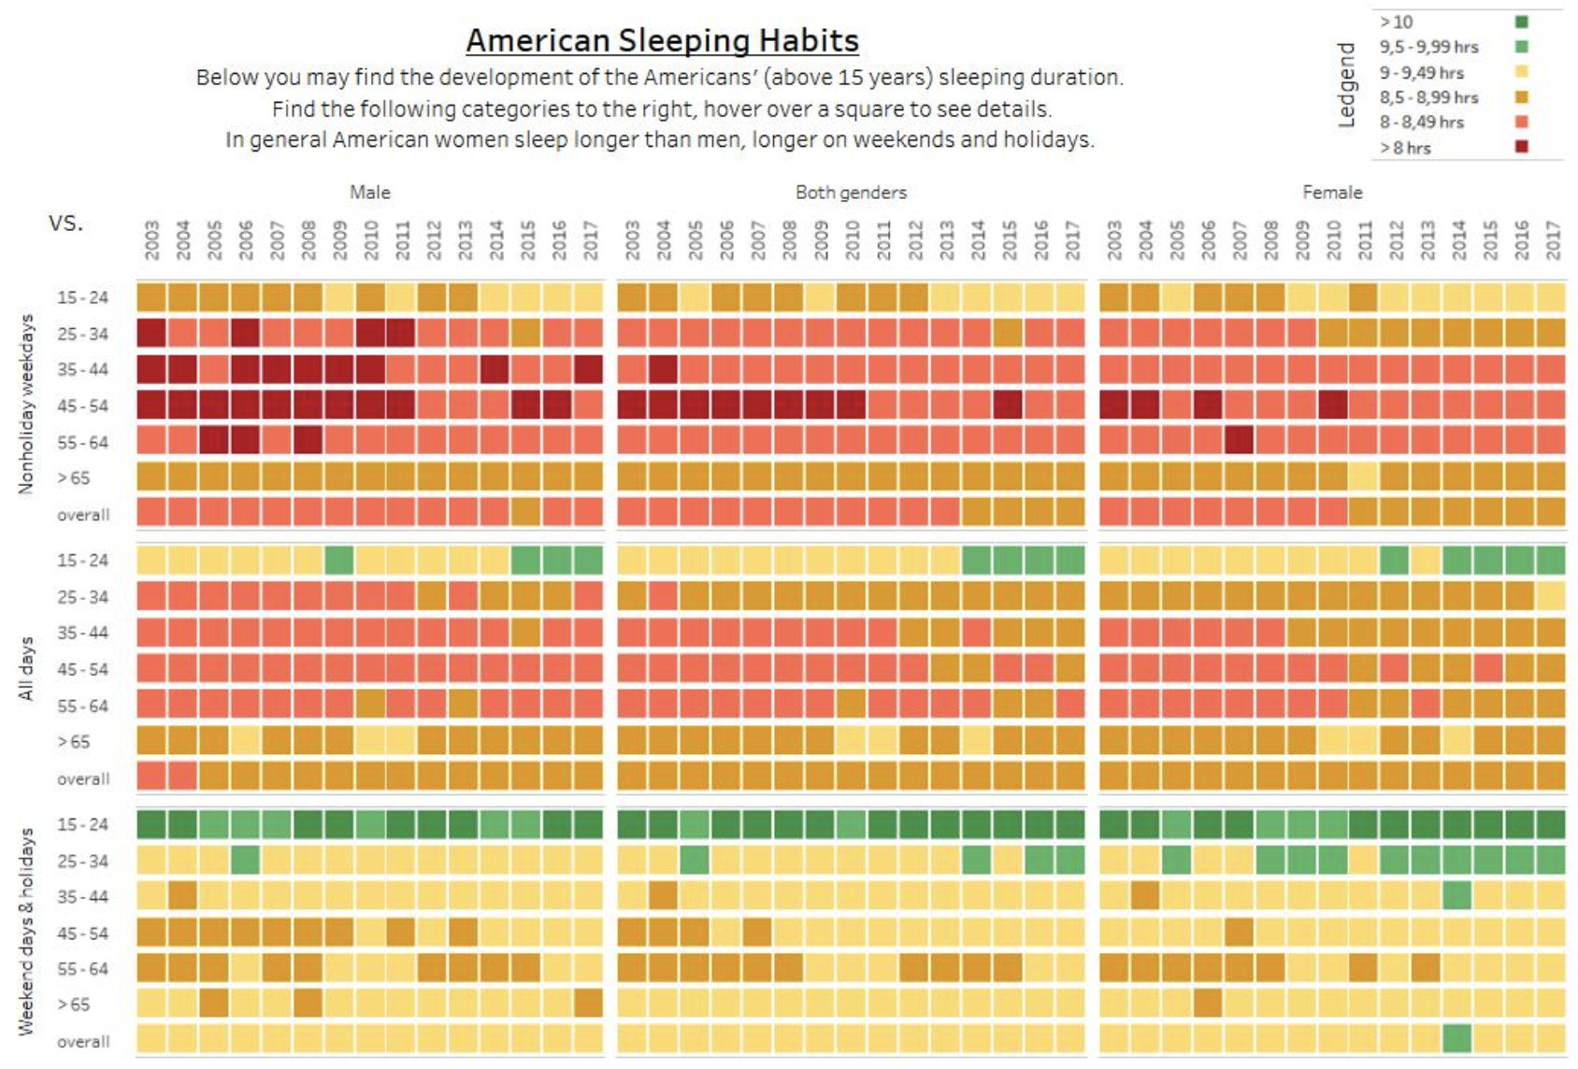
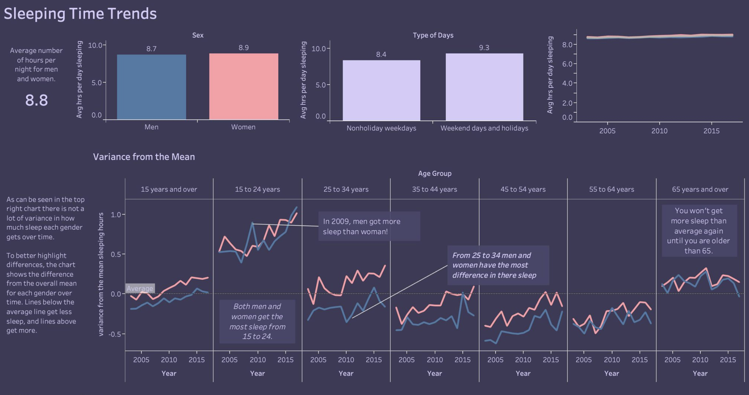
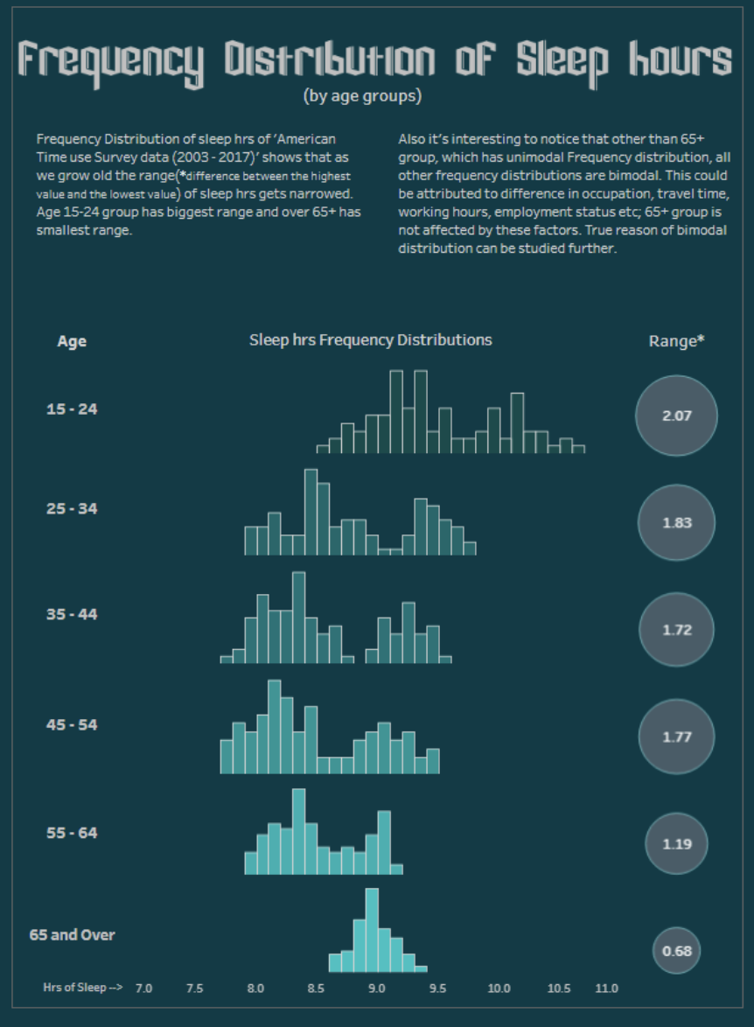
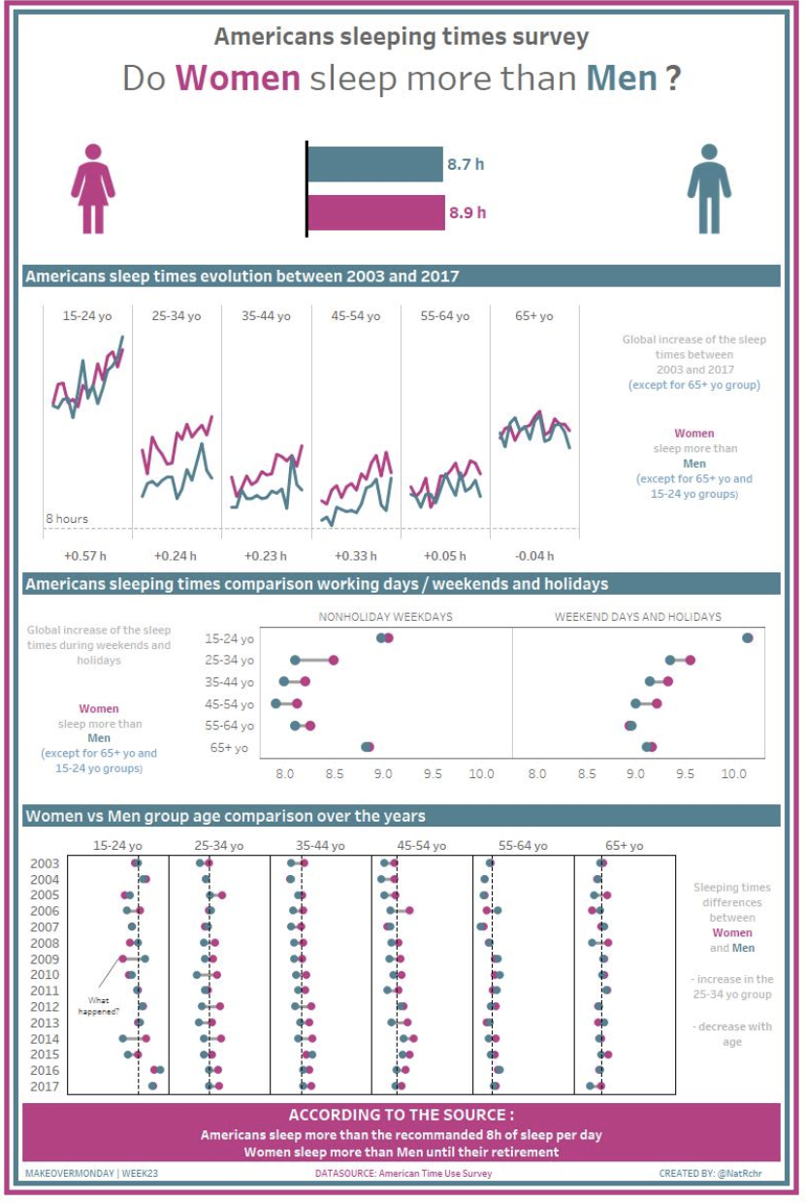
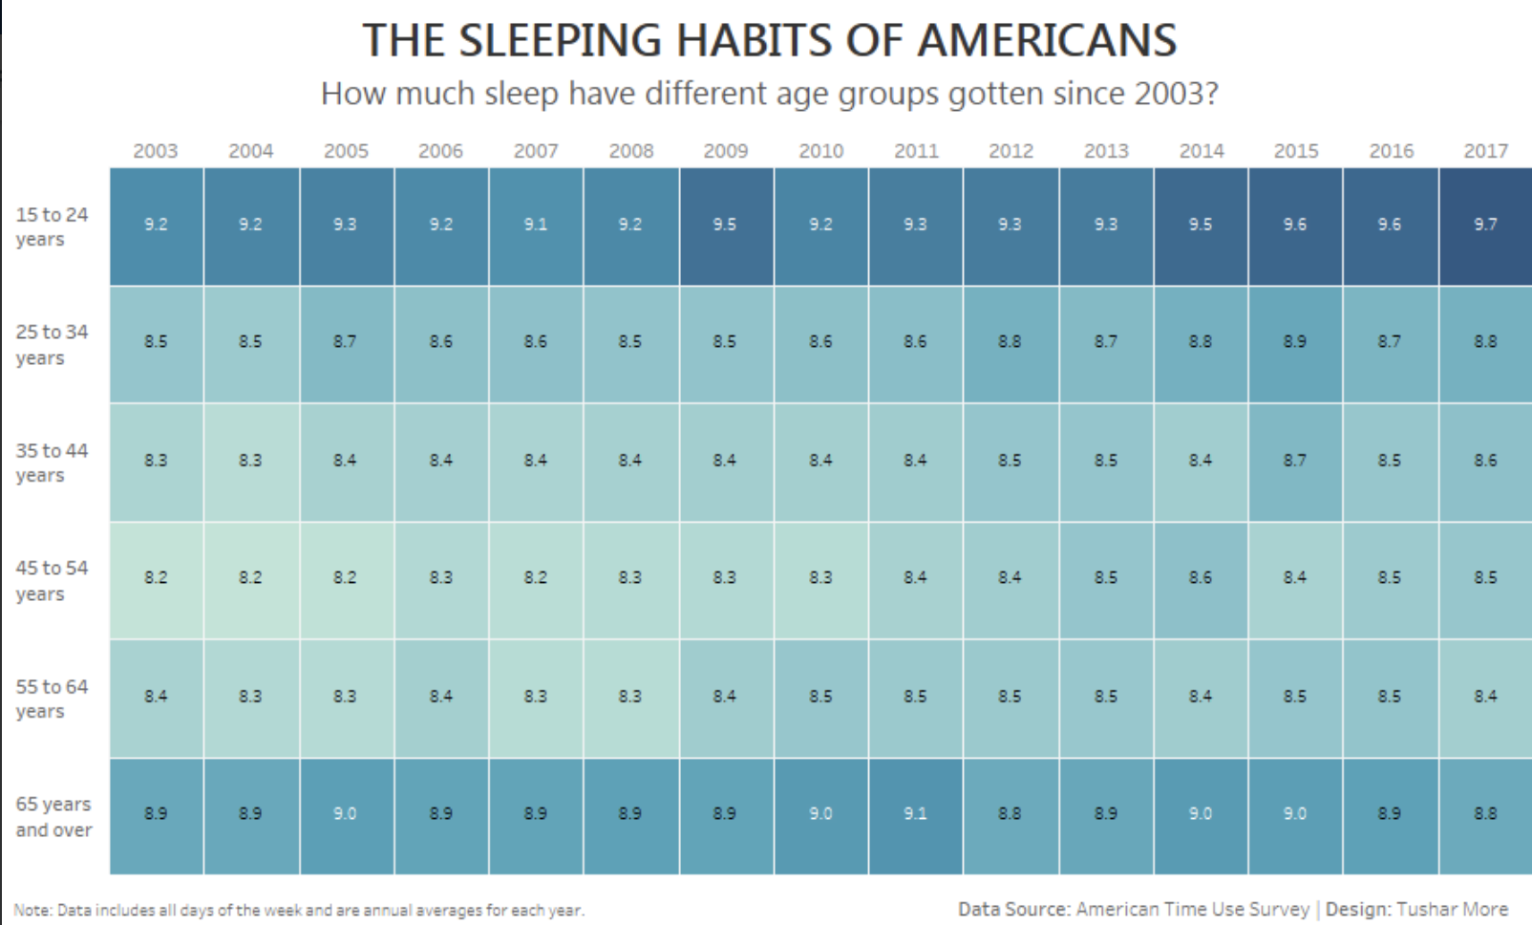
#MakeoverMonday
Notes:
Link to Makeover Monday

